Slide 1
Trading Strategies
25 March 2025

Slide 2
What exactly is a trading strategy?
A trading strategy is a set of rules that helps you decide when to buy and sell in the stock market to make a profit. Think of it like a game plan or a recipe for trading.
Buy Low Sell High (Long Strategy)
Sell High Buy Low (Short Strategy)
Here’s a simple way to understand it:
Look for Opportunities – You find assets that have a good chance of moving up or down in price.
Decide When to Buy – You use certain rules (like patterns in price, trends, or indicators) to know the best time to enter a trade.
Decide When to Sell – You also set rules for when to exit, either to take profits or to cut losses.
Manage Risk – You decide how much money to put into a trade and set a limit on how much you’re willing to lose.

Slide 3
How does someone make a strategy?
The answer to it is DATA
It is simple. A price action is a response to some world event. This event is reflected in the data. If the data never changes then there is no alpha. Thus, it is changes in the data that have the information. A change in information should produce a change in the alpha.
alpha : excess return an investment generates compared to a benchmark index
beta: an investment's sensitivity to market, indicating its volatility relative to the overall market.

Slide 4
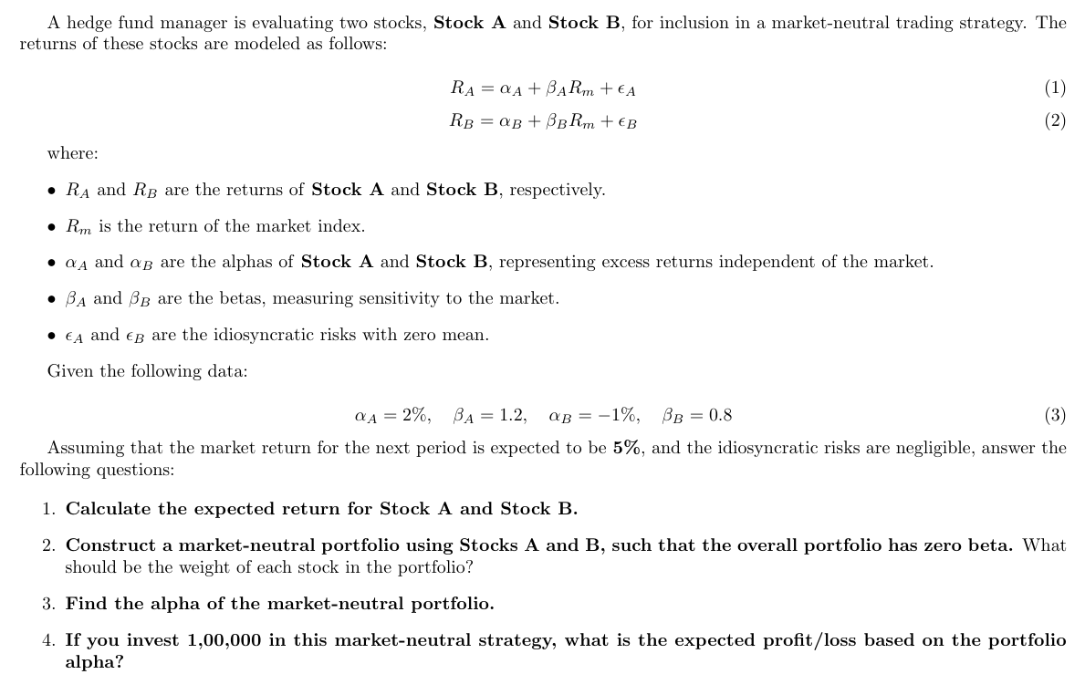

Slide 5
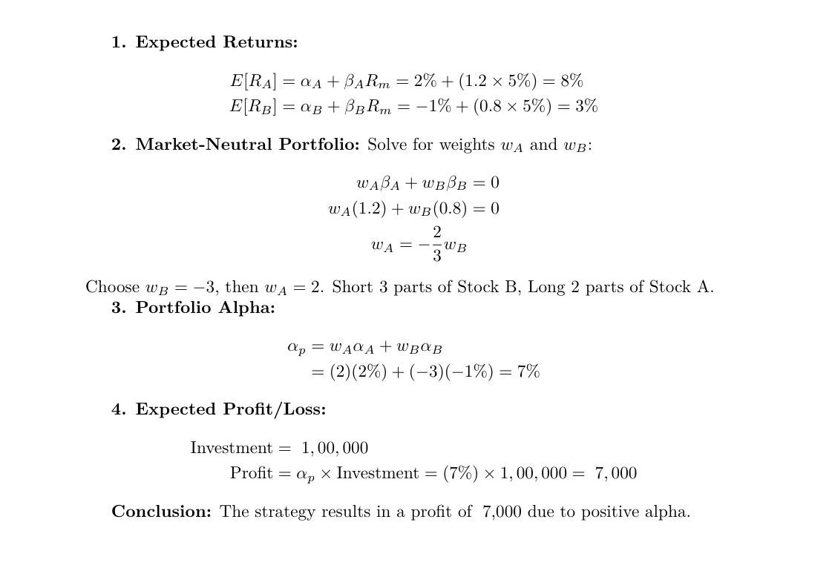

Slide 6
What makes a good strategy?
A High-Quality Trading Strategy Should:
Have a simple idea and expression.
Be expressed in an elegant and efficient manner.
Show a good in-sample Sharpe ratio (metrics).
Not be sensitive to small changes in data and parameters.
Have profits that hit a recent new high.

Slide 7
Alpha Design: Collecting Information
When building trading strategies, back testing models, or financial analysis tools, you can collect data from various sources like APIs, stock exchanges, brokers, and financial websites. yfinance is a good source for data for beginners.
Price Data
Open Price – The price at which an asset starts trading in a session.
High Price – The highest price reached in a session.
Low Price – The lowest price reached in a session.
Close Price – The price at which an asset closes in a session.
Volume – The number of shares or contracts traded
The other forms of data available is Fundamental Data, Sentimental Data, Macro & Economic Data, Derivatives Data, L2 Data (Market Depth).

Slide 8
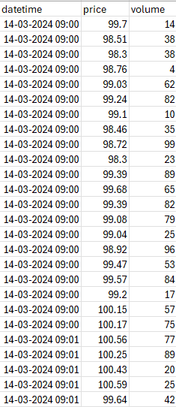
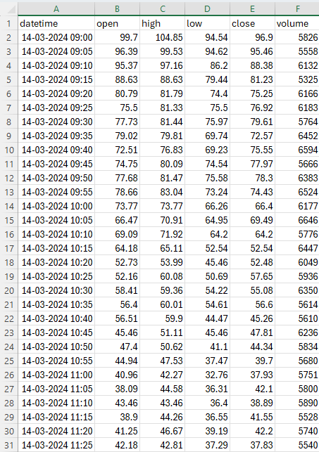
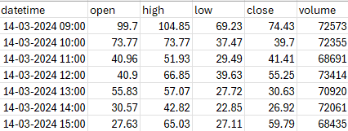
RESAMPLE
RESAMPLE
60 min OHLCV
Tick data
5 min OHLCV

Slide 9
Alpha Design: Hypothesis Testing
Go long when short term price average is more than long term price average (uptrend).
Go short when short term price average is less than long term price average (downtrend).
Buy Condition:
When the 20-period SMA crosses above the 50-period SMA, it indicates bullish momentum, triggering a buy signal. Buy at open of next candle.
Sell Condition:
When the 20-period SMA crosses below the 50-period SMA, it signals weakening momentum, triggering a sell signal. Sell at open of next candle.

Slide 10
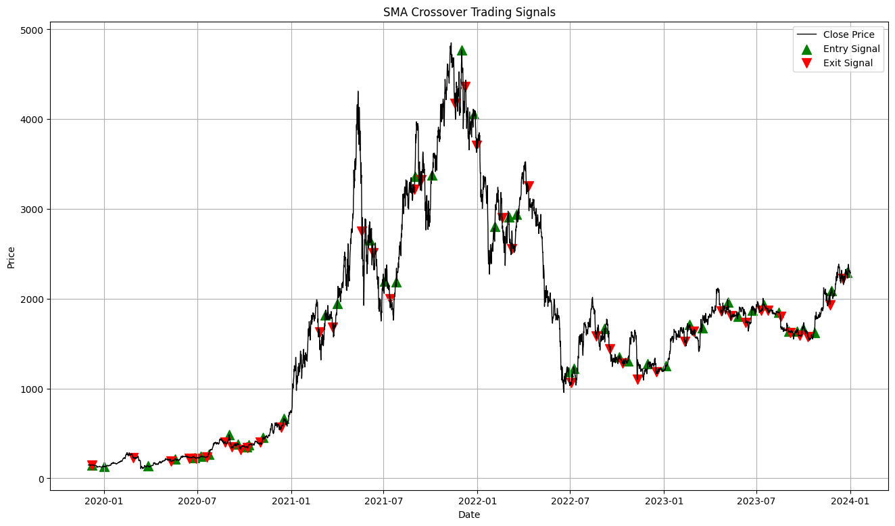

Slide 11
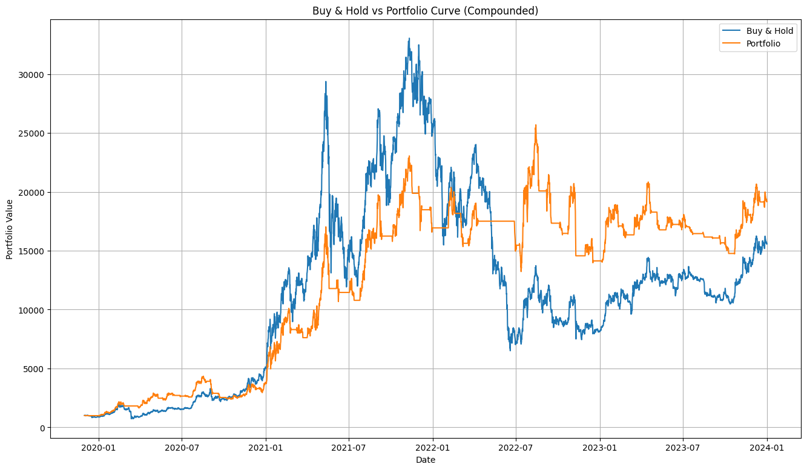

Slide 12
Improvement – I
Using EMA (Exponential Moving Average) instead of SMA
Faster Response – EMA reacts quickly to price changes, reducing lag.
Better Trend Detection – Identifies trend shifts earlier than SMA.
More Weight on Recent Prices – Gives higher importance to the latest data.
Improved Entry/Exit Timing – Helps capture moves sooner in volatile markets.
Avoids Delayed Signals – SMA lags more, causing late trade execution.

Slide 13
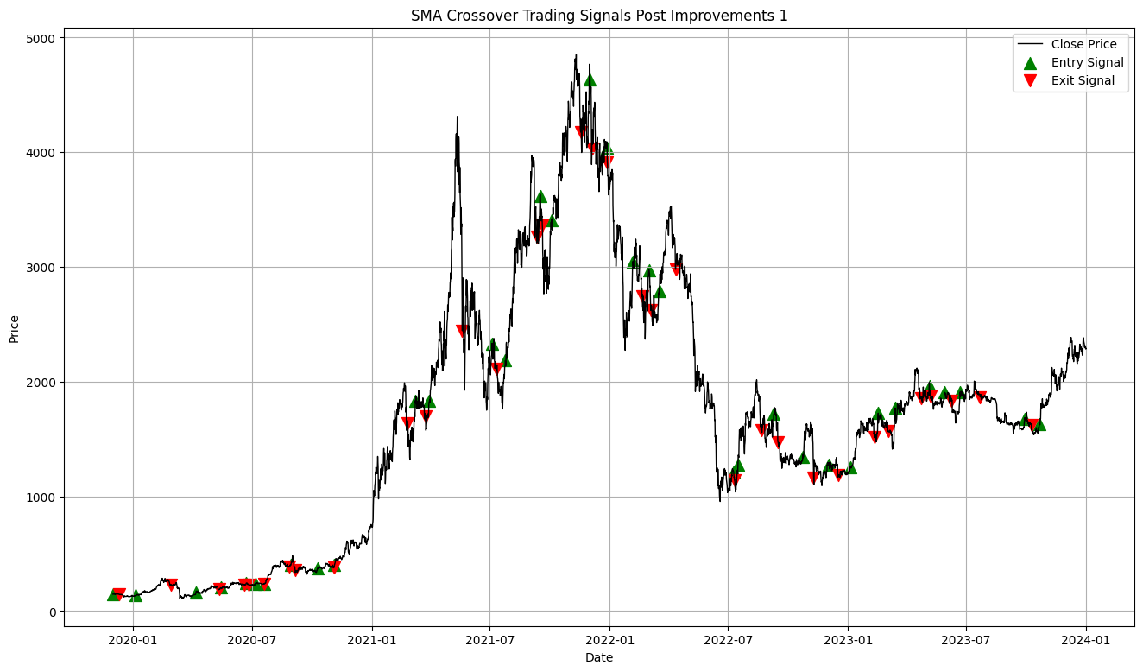

Slide 14
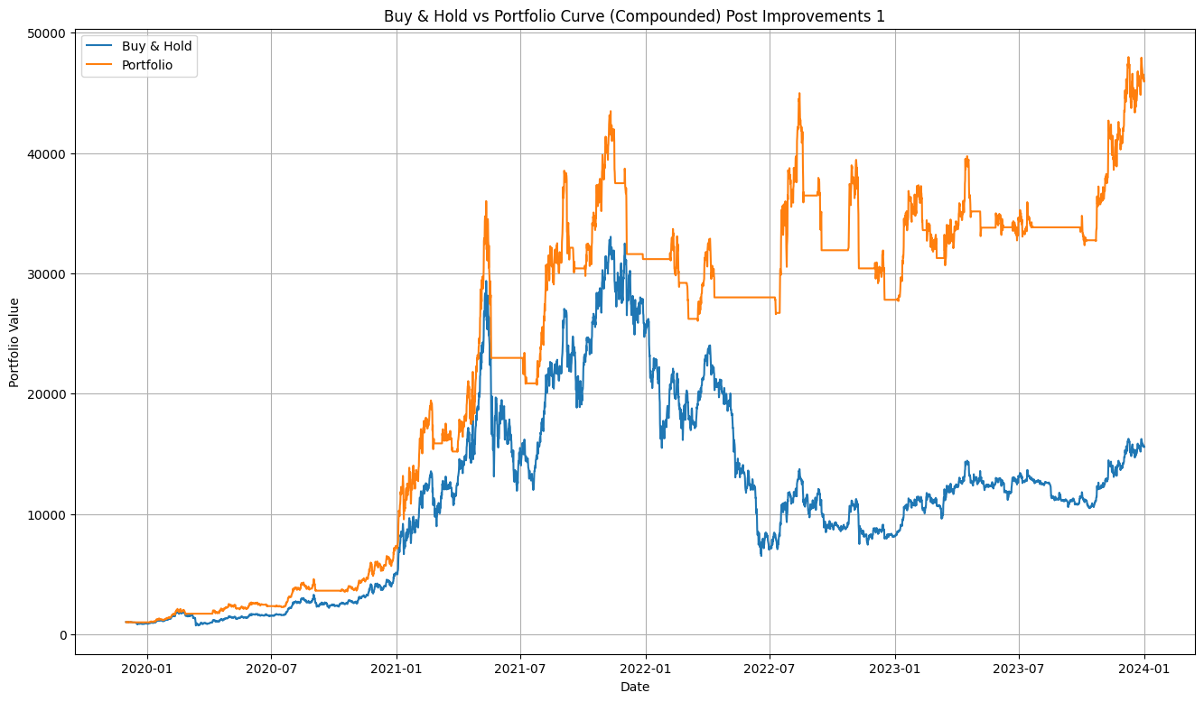

Slide 15
Improvement – II
We are missing a very important aspect of algorithmic trading which is Slippages and Transaction Costs.
Slippage
Execution Price Deviation – Orders may get executed at prices different from expected, leading to potential losses.
Higher Impact in Volatile Markets – Rapid price changes increase slippage, especially for large orders.
Transaction Cost
Reduces Net Profitability – Commissions, spreads, and fees eat into overall trading gains.
Limits Frequent Trading – High costs make high-frequency or short-term strategies less viable.

Slide 16
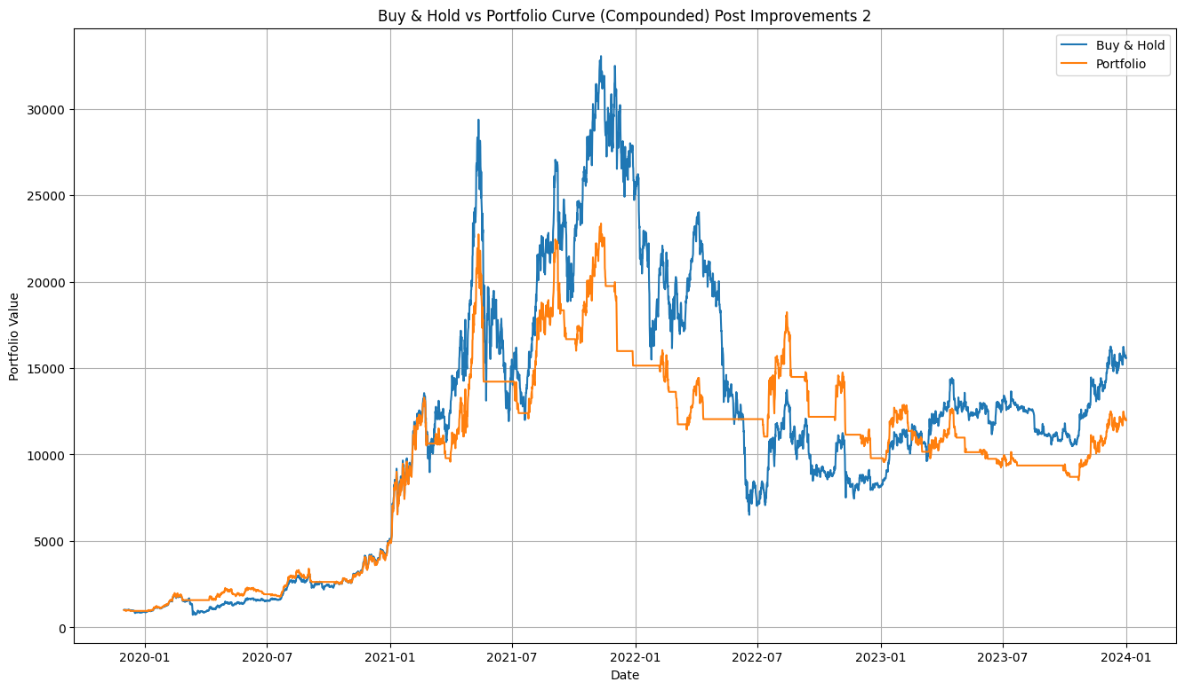

Slide 17
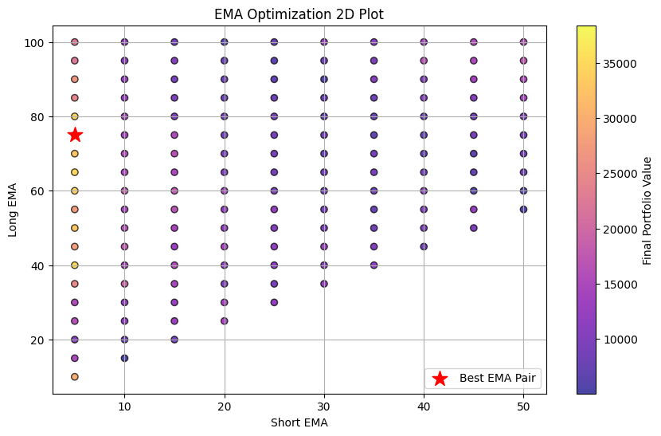
Improvement – III
Why only use EMA 20 and EMA 50 and not other parameter values?
Therefore, parameter optimization is the way to go.

Slide 18
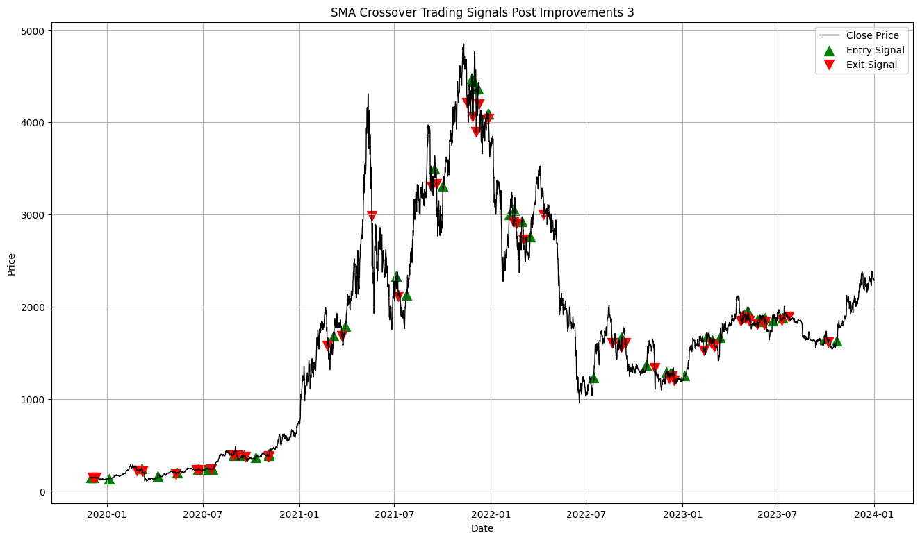

Slide 19
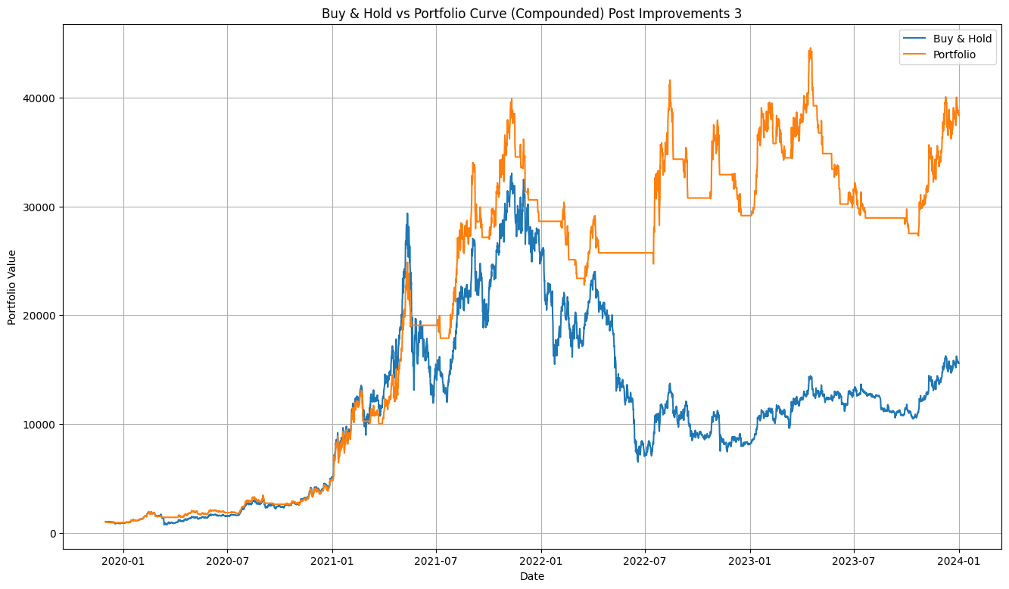

Slide 20
Improvement – IV
Add Specific Exit Points (Example: ATR-Based, Fixed Percentage (%))
Stop Loss Levels: to cut losses
Target Levels: to book profits

Slide 21
Parameter | Without SL & Target | With SL & Target
Risk Management | Limited control over losses | Controlled losses and profits
Drawdown | Potentially high | Reduced due to defined SL
Win Rate | May be higher (due to holding) | May decrease if SL is too tight
Reward-to-Risk Ratio | Undefined/Variable | Well-defined
Psychological Stress | Higher | Lower
Trade Longevity | Longer trades | Shorter, more frequent trades
Profit Consistency | Unpredictable | More consistent with disciplined exits
Slippage Impact | Potentially high | Limited if SL and Target are strict
Capital Protection | Weak | Strong
Overall Strategy Robustness | Dependent on strategy logic | Enhanced with disciplined exits

Slide 22
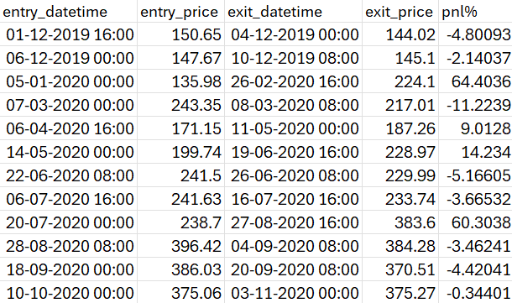
Create trade logs having Entry Datetime, Entry Price, Exit Datetime, Exit Price, PnL%.
It makes it easier to tackle bad trades and know exactly what is going on with the strategy.

Slide 23
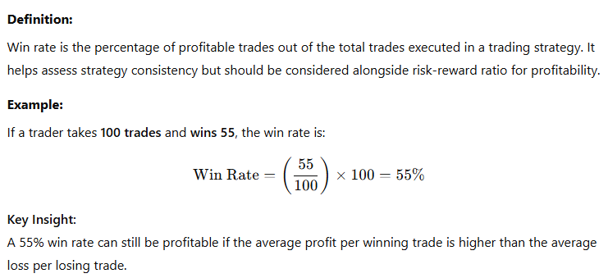
Alpha Design: Quantifying Performance
Win Rate

Slide 24
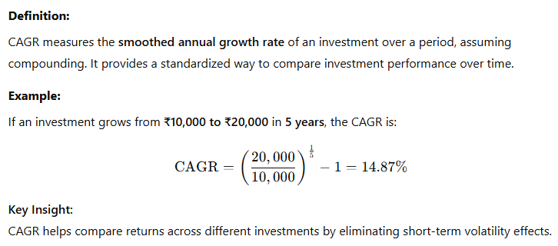
Alpha Design: Quantifying Performance
2. CAGR (Compound Annual Growth Rate)

Slide 25
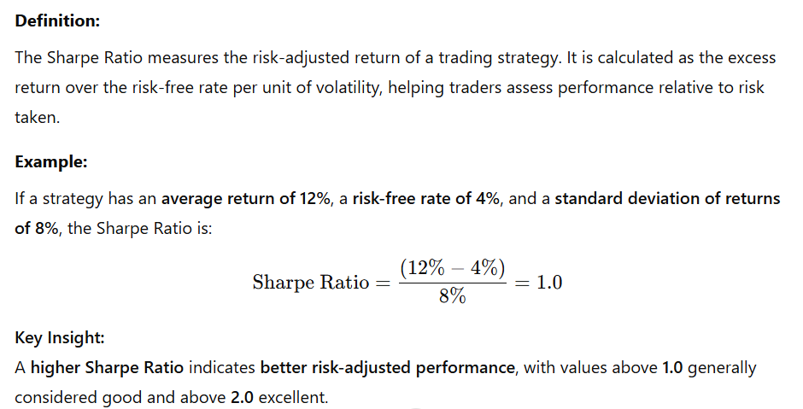
Alpha Design: Quantifying Performance
3. Sharpe Ratio

Slide 26
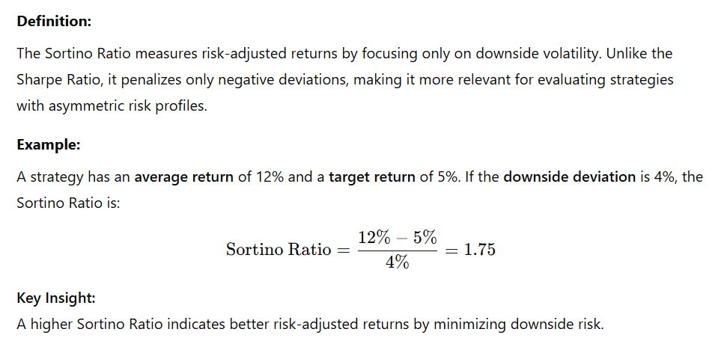
Alpha Design: Quantifying Performance
4. Sortino Ratio

Slide 27
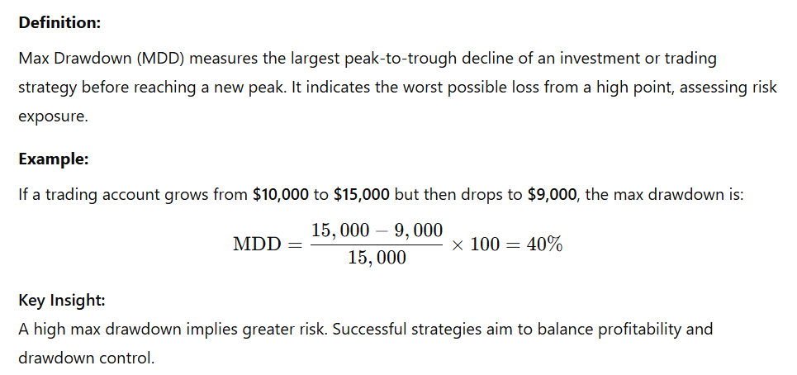
Alpha Design: Quantifying Performance
5. Max Drawdown

Slide 28
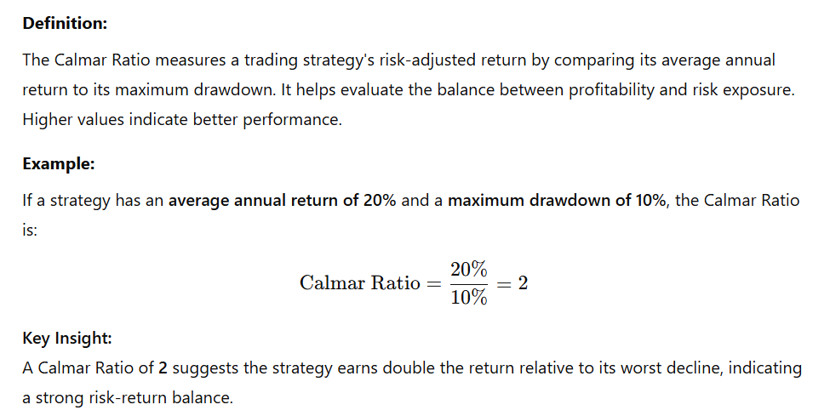
Alpha Design: Quantifying Performance
6. Calmar Ratio

Slide 29
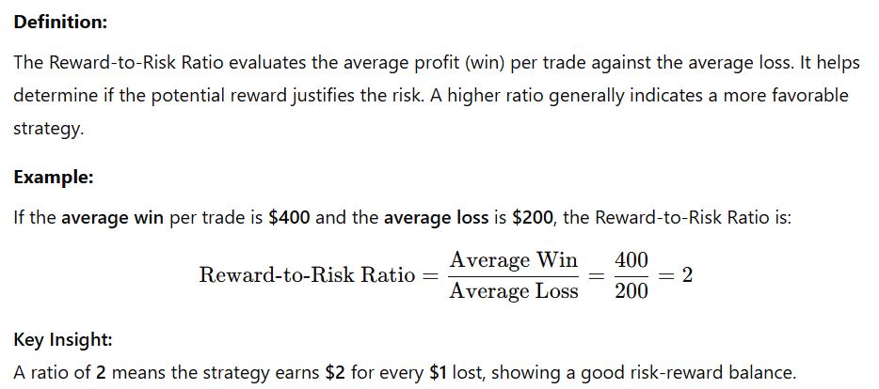
Alpha Design: Quantifying Performance
7. Reward-to-Risk Ratio

Slide 30
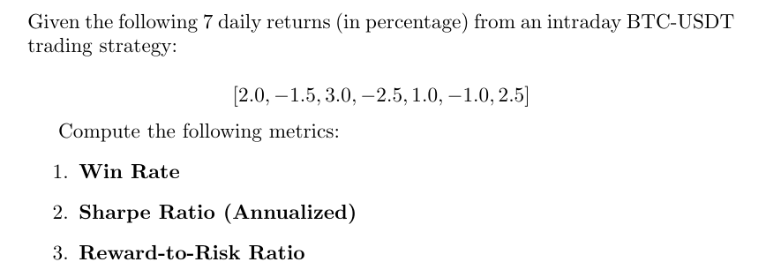

Slide 31
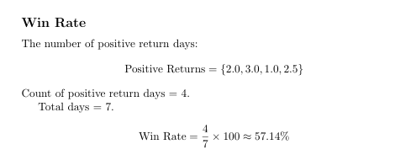
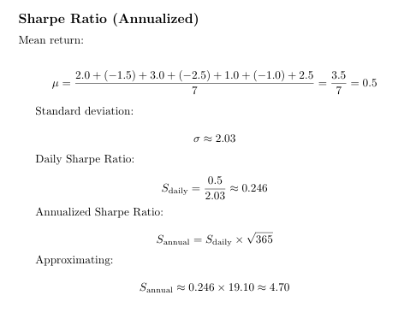
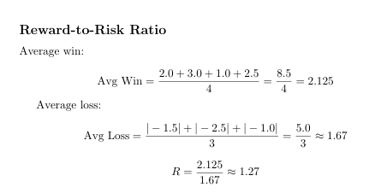

Slide 32
ASSIGNMENT
Develop an algorithmic trading strategy, aiming to outperform the benchmark while managing risk-reward effectively.
Dataset for 1y: SOLUSDT
Dataset for 2y: NIFTY_FUT (optional to participate)
The best performer of this assignment will be mentored for Inter IIT Tech Meet 2025.

Slide 33
Develop a robust backtester and calculate the following metrics:
Net Profit
Total Closed Trades
Win Rate (Profitability %)
Max Drawdown (Compounded)
Average Winning Trade (in USDT)
Average Losing Trade (in USDT)
Buy and Hold Return of SOL
Sharpe Ratio
Sortino Ratio
CAGR
Calmar Ratio
Average Holding Duration per trade
Assume 0.1% for transaction cost and slippages per transaction.
Make sure to avoid overfitting or any future bias in your strategy.

Slide 34
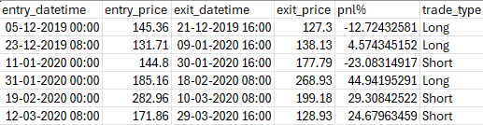
Deliverables:
PPT file explaining your strategy (Buy and Sell Criteria) and results.
Code (in Python)
Trade logs (csv)
Visualization (PnL Curve, Drawdowns, Buy and Sell Signals)
Trade logs must contain only 6 columns.
Deadlines (tentative):
Mid Review: 2nd April 2025
Final Review: 9th April 2025

Slide 35
How to look for ideas for strategies
Market Observation: Analyze historical price movements, trends, and patterns in various asset classes.
Quantitative Analysis: Use statistical and machine learning methods to identify inefficiencies.
Technical Indicators: Experiment with moving averages, RSI, MACD, ATR, and ADX.
Market Anomalies: Look for seasonal effects, momentum, and mean reversion opportunities.
Reading Papers & Books: Gain insights from academic research and trading books.
Community & Forums: Engage in trading communities (e.g., QuantConnect, TradingView).

Slide 36
Evolution of My Strategies
Combination of Indicators
Market Neutral Strategies
Custom Indicators and Leveraged Approach
High Frequency Models

Slide 37
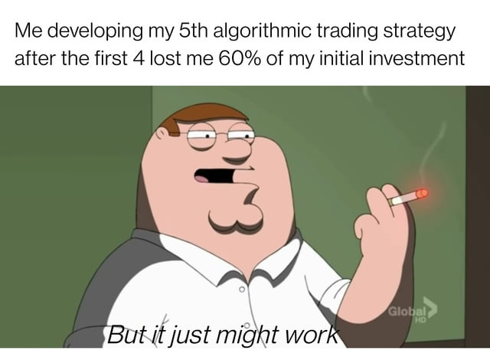

Slide 38
Further Resources
Rayner Teo – YouTube
Blog - QuantifiedStrategies.com
TraderLion – YouTube (Advanced)
A.o.T Blog | The Art Of Trading
Trading Ideas and Technical Analysis From Top Traders
neurotrader – YouTube (Advanced ++)

Slide 39
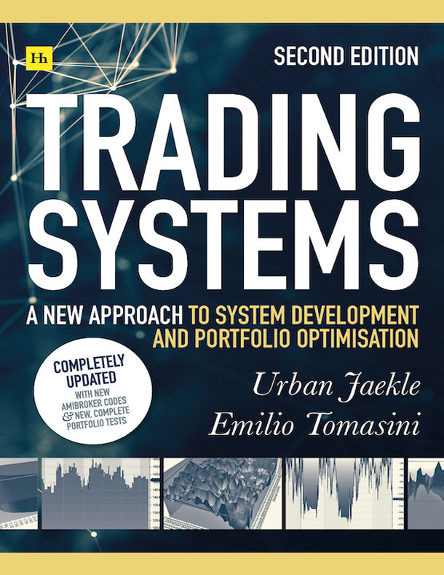
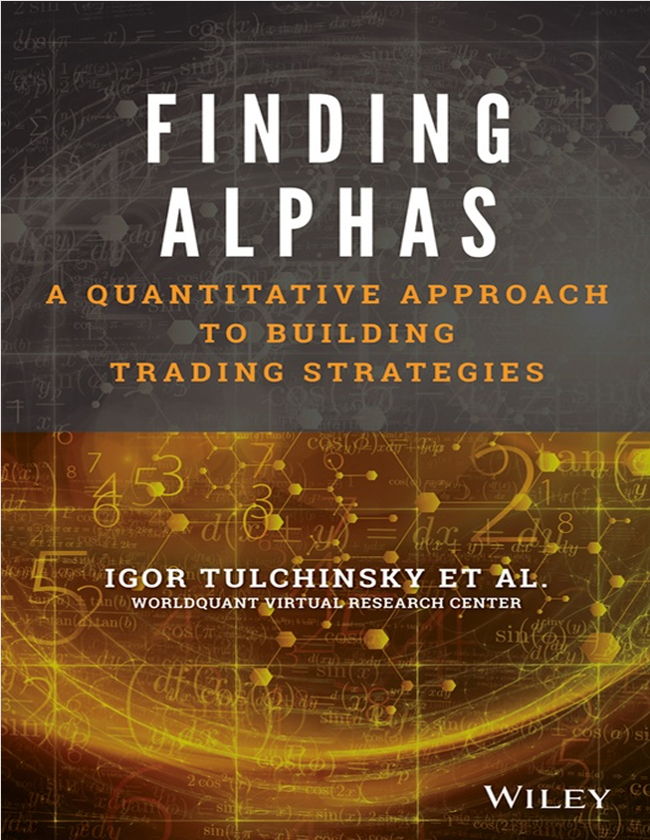
Further Resources

